Slide 1
DIXON SEQUENCES IN MSK MRI: WHAT FOR ?
AFIIM – ISRA Tel Aviv May 2015
Jean Luc DRAPÉ
Henri GUERINI
Paris Descartes University
Cochin Hospital
Paris, France
jean-luc.drape@aphp.fr

Slide 2
FAT SUPPRESSION
Mandatory in MSK MRI
Increases the contrast
Better anatomical details
Higher detection of lesions
Several techniques

Slide 3
FAT SUPPRESSION TECHNIQUES
CHEMICAL SHIFT
INVERSION
HYBRID
STIR
SPAIR
SPIR
CHESS
(fatsat)
Water
Excitation
DIXON
(fat water separation)

Slide 4
DIXON

Slide 5
DIXON
Keeping the fat

Slide 6
DIXON
Suppressing the fat

Slide 7
DIXON: GOALS
TO GET SEQUENCES WITHOUT AND WITH
FAT SUPPRESSION:
If possible with only one acquisition time
If possible with the same weighting (T1 or T2)
If possible with a high quality of fat suppression

Slide 8
WHAT IS DIXON ?
208Hz
2.4 ms
4.8 ms
FAT
WATER
OUT OF PHASE
IN PHASE

Slide 9
WHAT IS DIXON ?
208Hz
2.4 ms
4.8 ms
FAT
WATER
OUT OF PHASE
IN PHASE

Slide 10
LE DIXON, C’EST QUOI ?
EAU
EAU

Slide 11
WHAT IS DIXON ?
EAU
EAU
2

Slide 12
WHAT IS DIXON ?
EAU
2

Slide 13
WHAT IS DIXON ?
EAU
GRAISSE

Slide 14
WHAT IS DIXON ?
EAU
2

Slide 15
DIXON T2 OUT
DIXON T2 IN
DIXON T2 WATER
EAU
2

Slide 16
DIXON T2 OUT
DIXON T2 IN
DIXON T2 FAT
DIXON T2 FAT
EAU
2

Slide 17
DIXON PD
DIXON PD WATER
DIXON PD FAT

Slide 18
DIXON SEQUENCES
PHILIPS | GE | SIEMENS | TOSHIBA
mDIXON | IDEAL (3 pts) FLEX (2 pts) | DIXON | WFOP
DIXON Techniques 2, 3 & 4 points: more robust (fat water swapping)

Slide 19
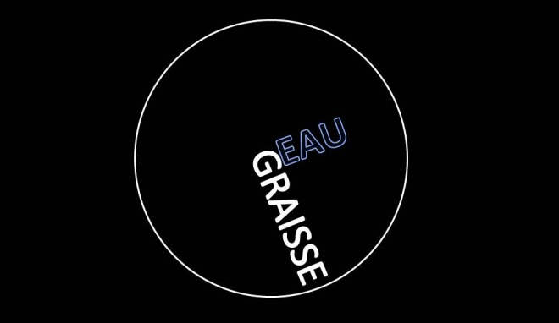
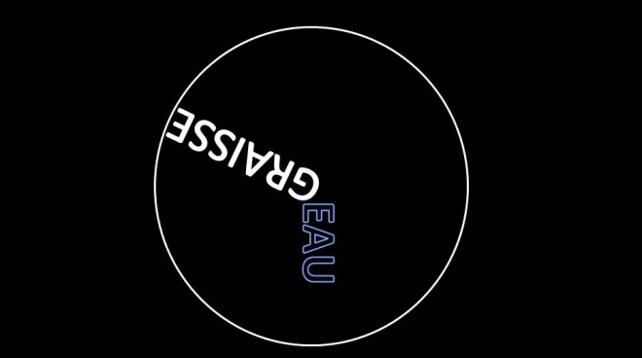
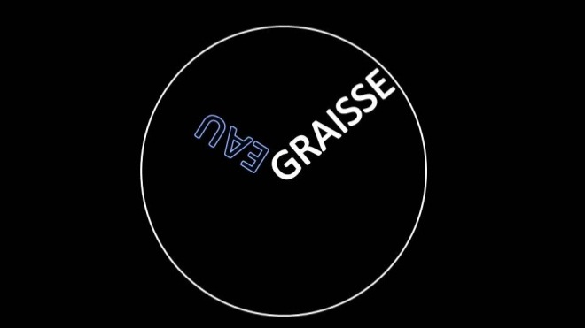
FAT WATER SWAPPING
Dixon 3 pts
DIXON T2 FAT
DIXON T2 WATER
IDEAL (GE)

Slide 20
ADVANTAGES / DISADVANTAGES
Metal
Artifact
B0
pref
TAcq
SNR
SAR
Se B0
Se B1
CHESS
Short
Long
Long
Long
Short
Long
High
Low
High
High
High
High
Moderate
High
High
High
Low
Low
High
Min
High
High
High
Min
Se
No
Se
Se
Se
No
3-4pts
Se
No
Se
No
No
No
High
NA
High
High
Med
Med
STIR
SPIR
SPAIR
WE
DIXON

Slide 21
CHESS vs STIR vs DIXON T2 W
T2 FAT SAT
STIR
DIXON T2 W
3mn14s
3mn38s
3mn17s

Slide 22
ROBUST FAT SUPPRESSION
Higher quality than fat saturation
Large FOV
Spine, pelvis, bilateral hands
Difficult anatomic areas
Peripheral joints: shoulder, elbow
Air environment: hind foot

Slide 23
FAT SEPARATION
FAT SAT
T1 FAT SAT GADO
T1 DIXON WATER GADO

Slide 24
FAT SAT vs DIXON T2 W
T2 FAT SAT
T2 DIXON WATER

Slide 25
FAT SAT vs DIXON T2 W
T2 FAT SAT
T2 DIXON WATER

Slide 26
ROBUST FAT SUPPRESSION
Higher quality than fat saturation
High accuracy of detection of Gadolinium enhancement with DIXON T1 W

Slide 27
STIR vs DIXON T1 W GADO
STIR
DIXON T1 W Gado

Slide 28
STIR vs DIXON T1 W GADO
STIR
DIXON T1 W Gado

Slide 29
OTHER ADVANTAGES
To get a sequence without and with fat suppression within the same acquisition time
Is T1 yet useful ?

Slide 30
T2 W vs T2 F
Stress fracture
T2 DIXON WATER
T2 DIXON FAT

Slide 31
T1 vs DIXON T2 IN
Stress fracture
T2 DIXON IN [water + fat] ≈ PD
T1
T2 DIXON IN

Slide 32
T2 IN vs T2 W
DIXON T2 IN
DIXON T2 WATER

Slide 33
T2W vs T2F
To get a « fat » sequence
DIXON T2 WATER
DIXON T2 FAT
T1

Slide 34
T1 vs DIXON T2 F
Higher contrast than T1
T1
DIXON T2 FAT

Slide 35
T1 vs DIXON T2 F
Higher contrast than T1
T1
DIXON T2 FAT

Slide 36
T1 vs DIXON T2 F
Higher contrast than T1
T1
DIX T2 W
DIX T2 FAT

Slide 37
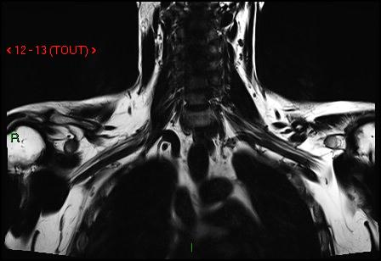
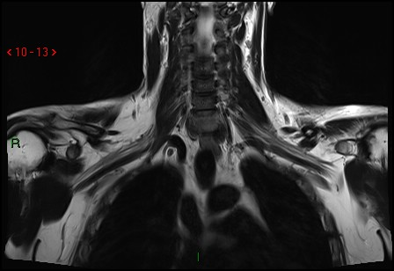
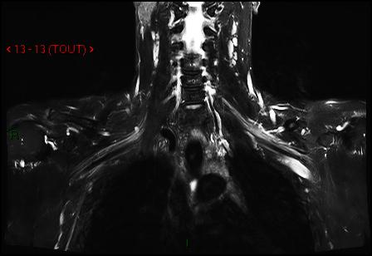
BRACHIAL PLEXUS
To get a « fat » sequence

Slide 38
RHEUMATOID ARTHRITIS
T1
DIXON T2 FAT
DIXON T2 WATER
Active and structural lesions during the same sequence

Slide 39
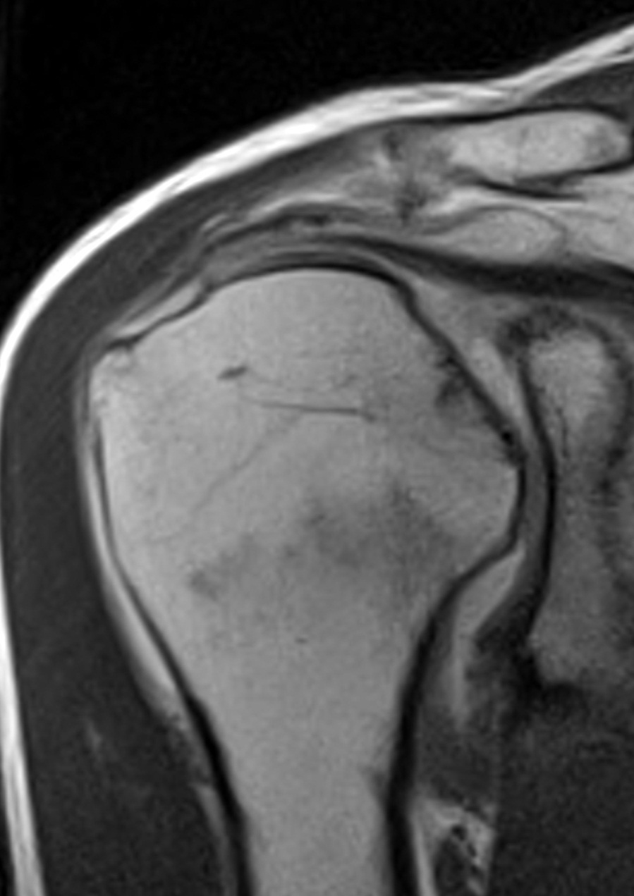
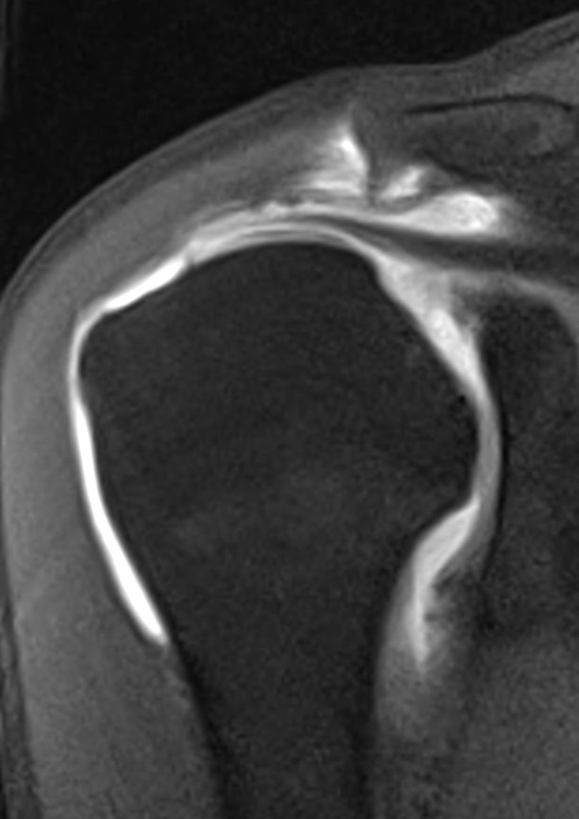
DIXON T1 IN & W
MR arthrography
DIXON T1 GADO IN
DIXON T1 WATER

Slide 40
OTHER ADVANTAGES
Medullar edema vs tumor infiltration
Read the images OUT & IN
OUT = water – fat vs IN = water + fat
Edema: dramatic decrease of signal OUT vs IN (persistent bone marrow)
Tumor: lower decrease of signal OUT vs IN [no more fat] < 35% (VPP 100% & VPN 95.2%)
Erly WK et al. AJNR 2006;27(6):1183-8

Slide 41
IN/OUT RATIO
T1 IN
T1 OUT
T1 FAT
T1 W

Slide 42
QUANTIFICATION OF FAT AND DIXON
Mapping % fat/voxel
But T2* effect, multipick fat spectrum

Slide 43
DIXON T2 OUT
Sensitive to trabecular bone alterations
T1
DIX T2 F
DIX T2 OUT
DIX T2 W

Slide 44
VERTEBRAL ANGIOMA
T1
DIX T2 OUT
DIX T2 W

Slide 45
BONE vs DISC: DIXON T2 OUT
DIX T2 OUT
DIX T2 F
DIX T2 W

Slide 46
OTHER ADVANTAGES
Low sensitivity to metal artifacts ?

Slide 47
FS/DIXON AND METAL

Slide 48
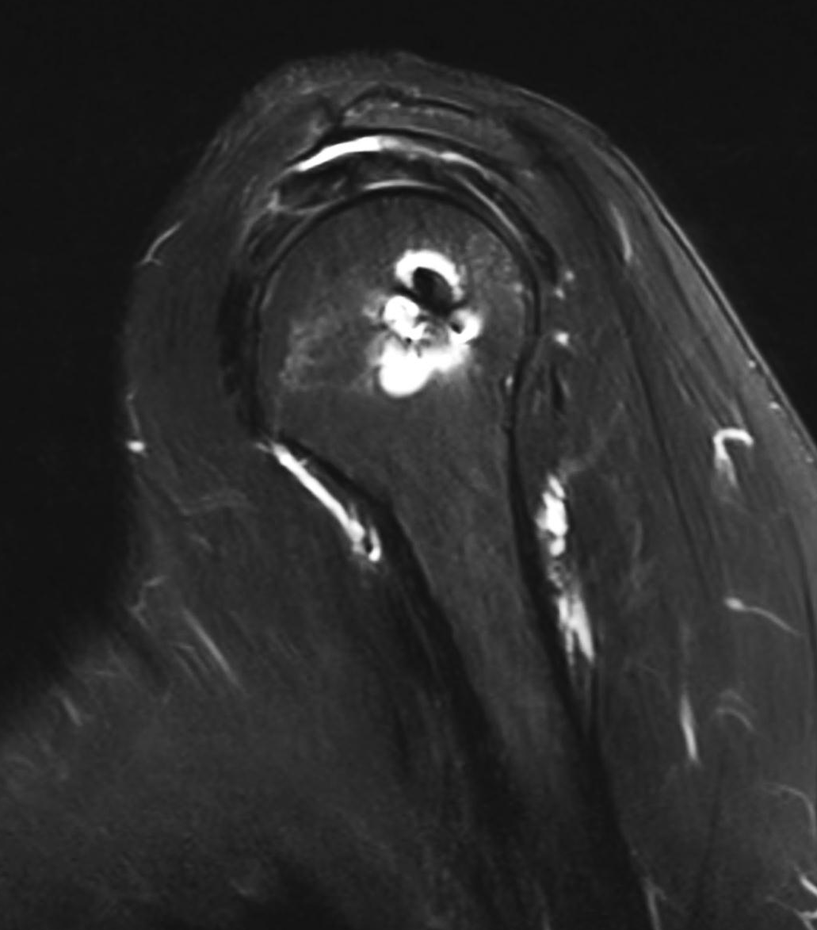
FS/DIXON AND METAL

Slide 49
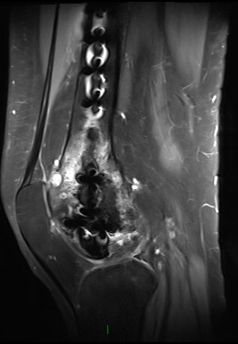
STIR/DIXON AND METAL
DIXON GADO
T1
STIR

Slide 50
DIXON AND METAL
T2 FAT SAT
DIXON T2 WATER
Spine

Slide 51
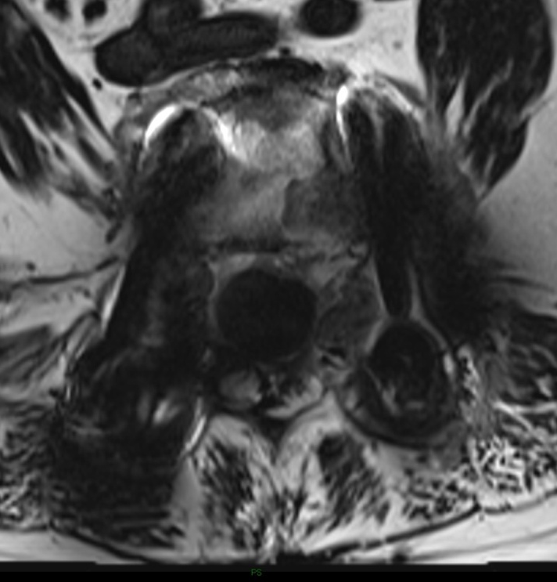
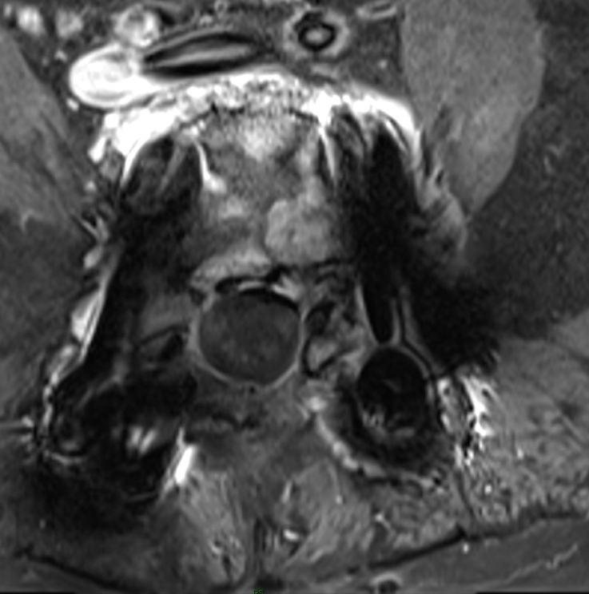
DIXON AND METAL
T1 Gado
T1 FS Gado
DIX T1 W Gado

Slide 52
TAKE HOME POINTS
DIXON sequences
Routinely used: very robust
Substitutes STIR or T2FS
Substitutes T1 Gadolinium FS
Large FOV
Difficult FS anatomical areas
Look at other images thanT1w or T2w

